Slide 1

PROACC
User Guide

Slide 2
Index
Admin
Project Manager
Consultant
Customer

Slide 3
Admin
Menu
Dashboard
User Settings
Configuration
Miscellaneous
Reports
PROACC Survey Mail

Slide 4
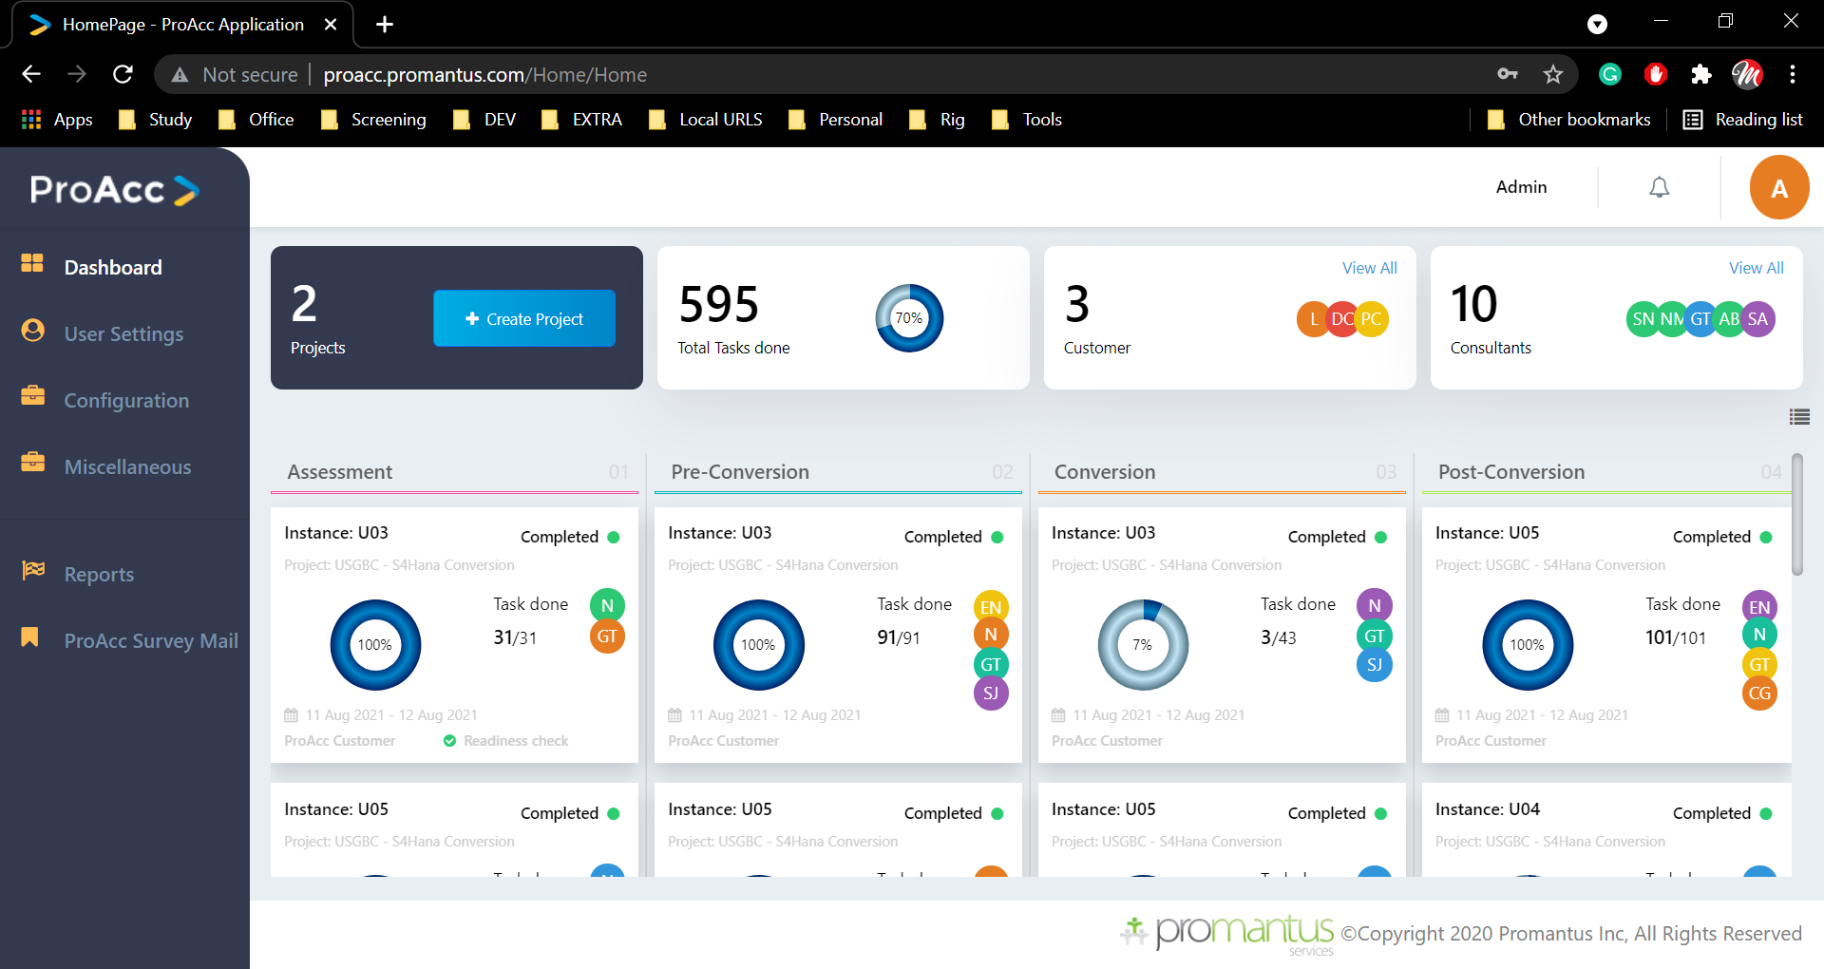
DashBoard
This will be the landing page of the application. This will show all project counts, Task counts, customer counts, consultants count, and different stages of the application like
Structure Flow
Assessment
Pre-conversion
Conversion
Post-conversion
This is the skeleton flow of this application concerning the order
Below view which is unique to the user login.

Slide 5
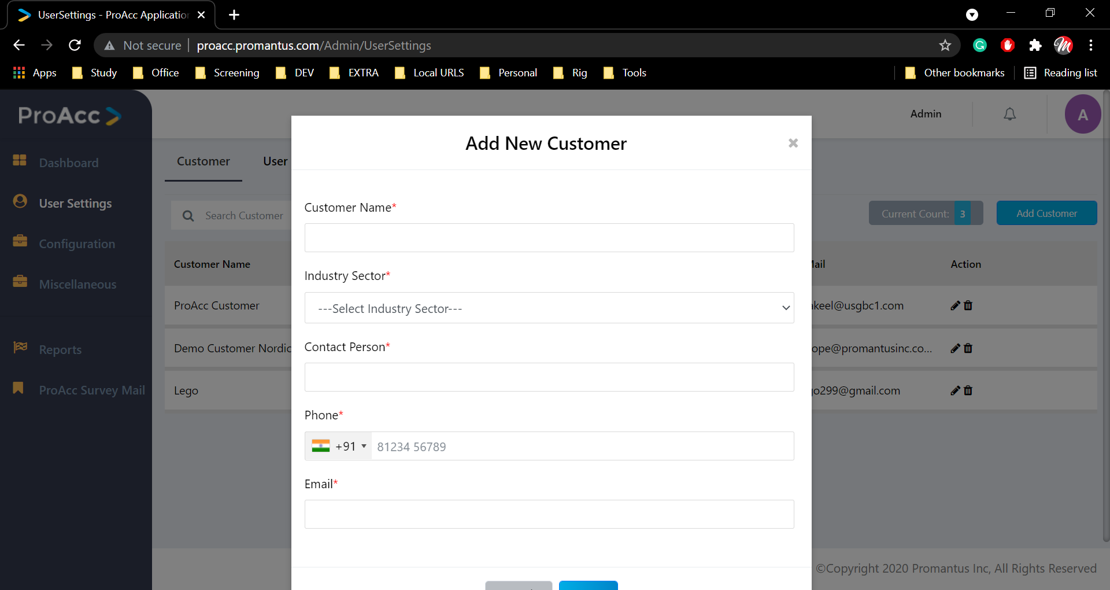
User Settings
Here we have two sub-tabs
1. Customer
2. User
Customer :
We can Create , update , read(list),delete customer here (CURD)

Slide 6
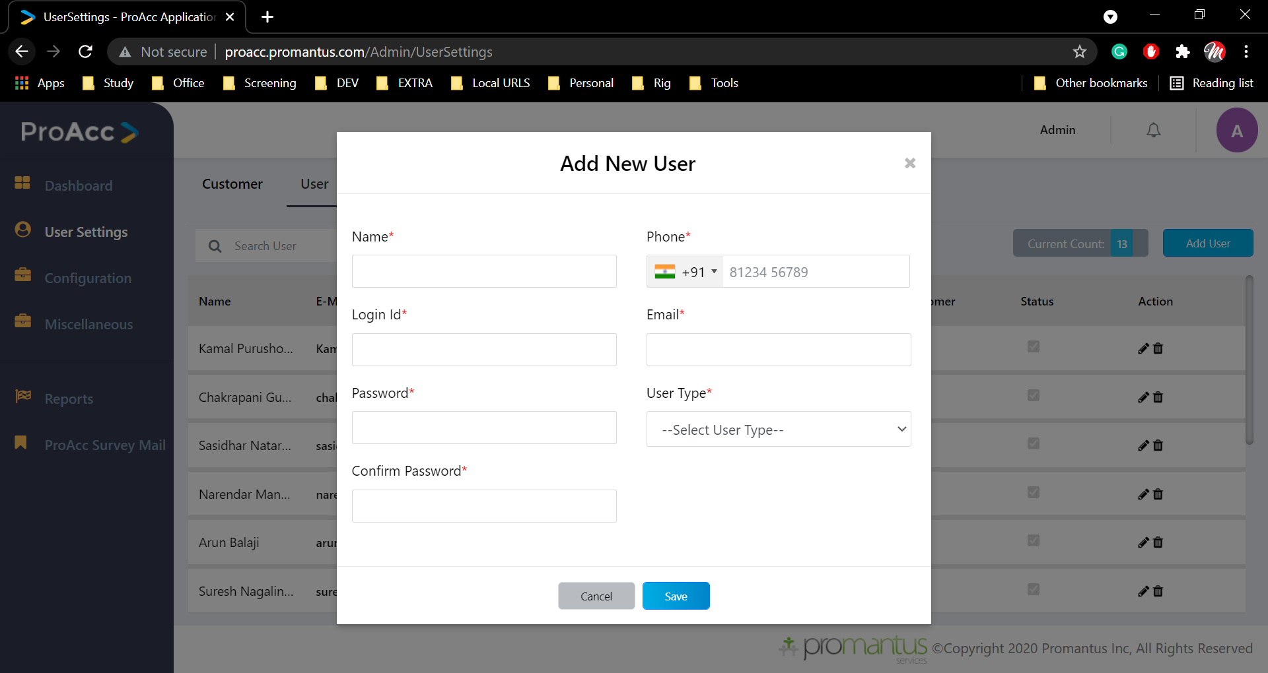
User Settings
User:
We can do CURD for user here
We are creating users with respect to user type’s that is selected
Admin
Project manager
Customer –providing them with role & customer selection
consultant- providing the role

Slide 7
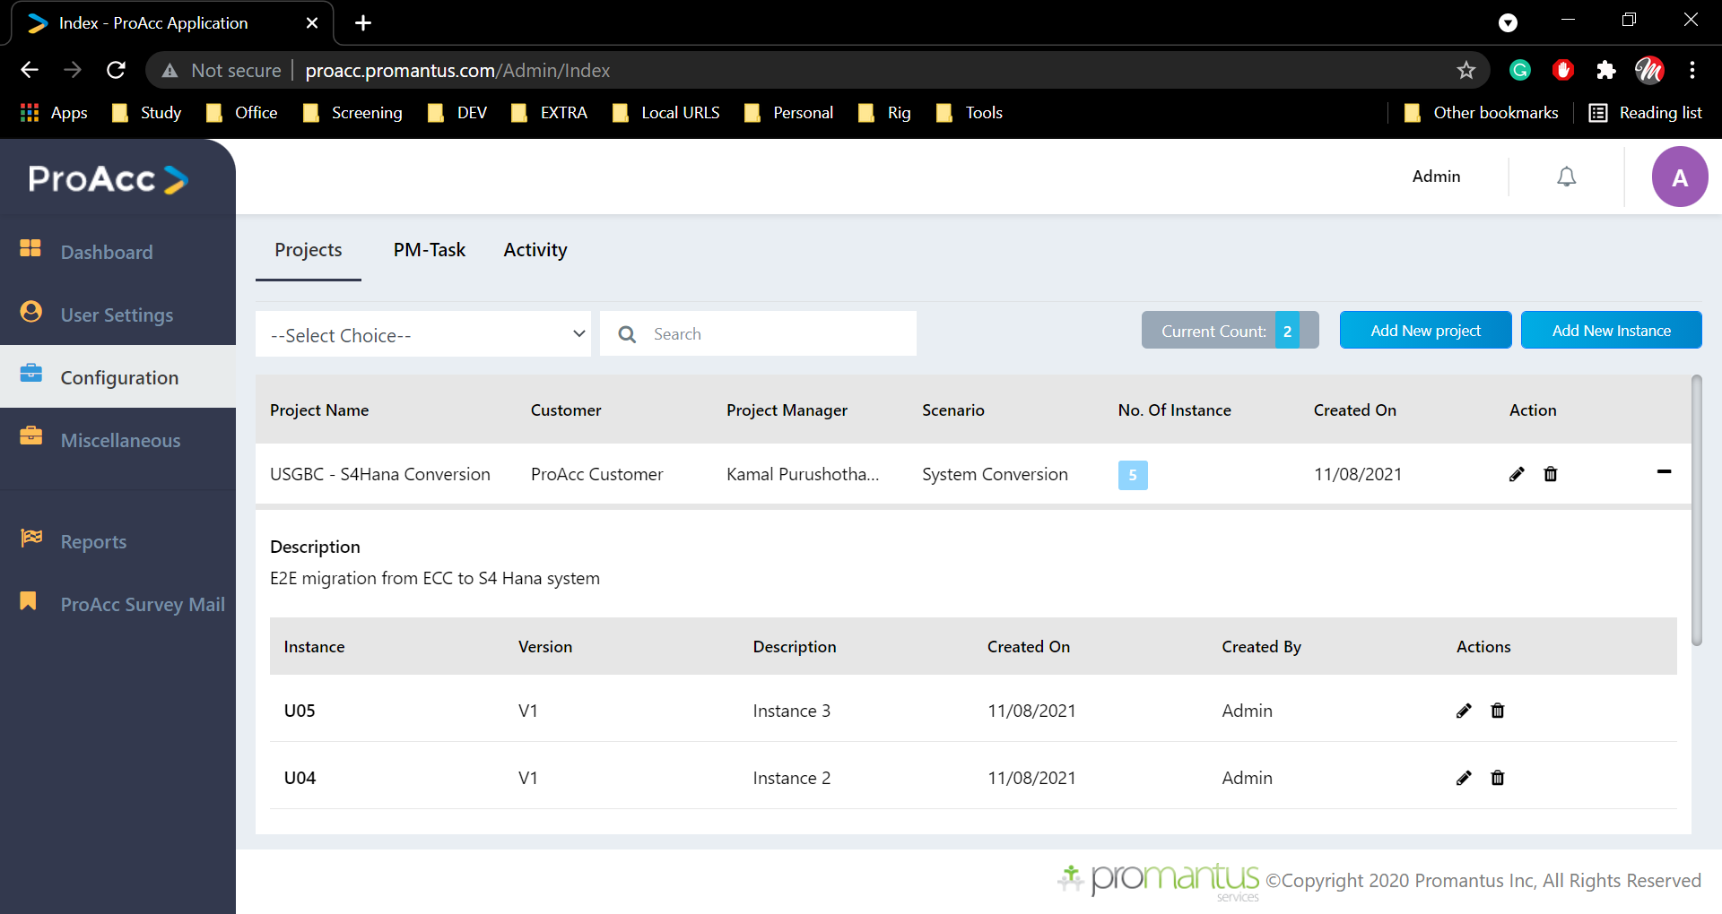
Configuration
Here we have three sub-tabs
Project’s
PM-Task (Project manager)
Activity

Slide 8
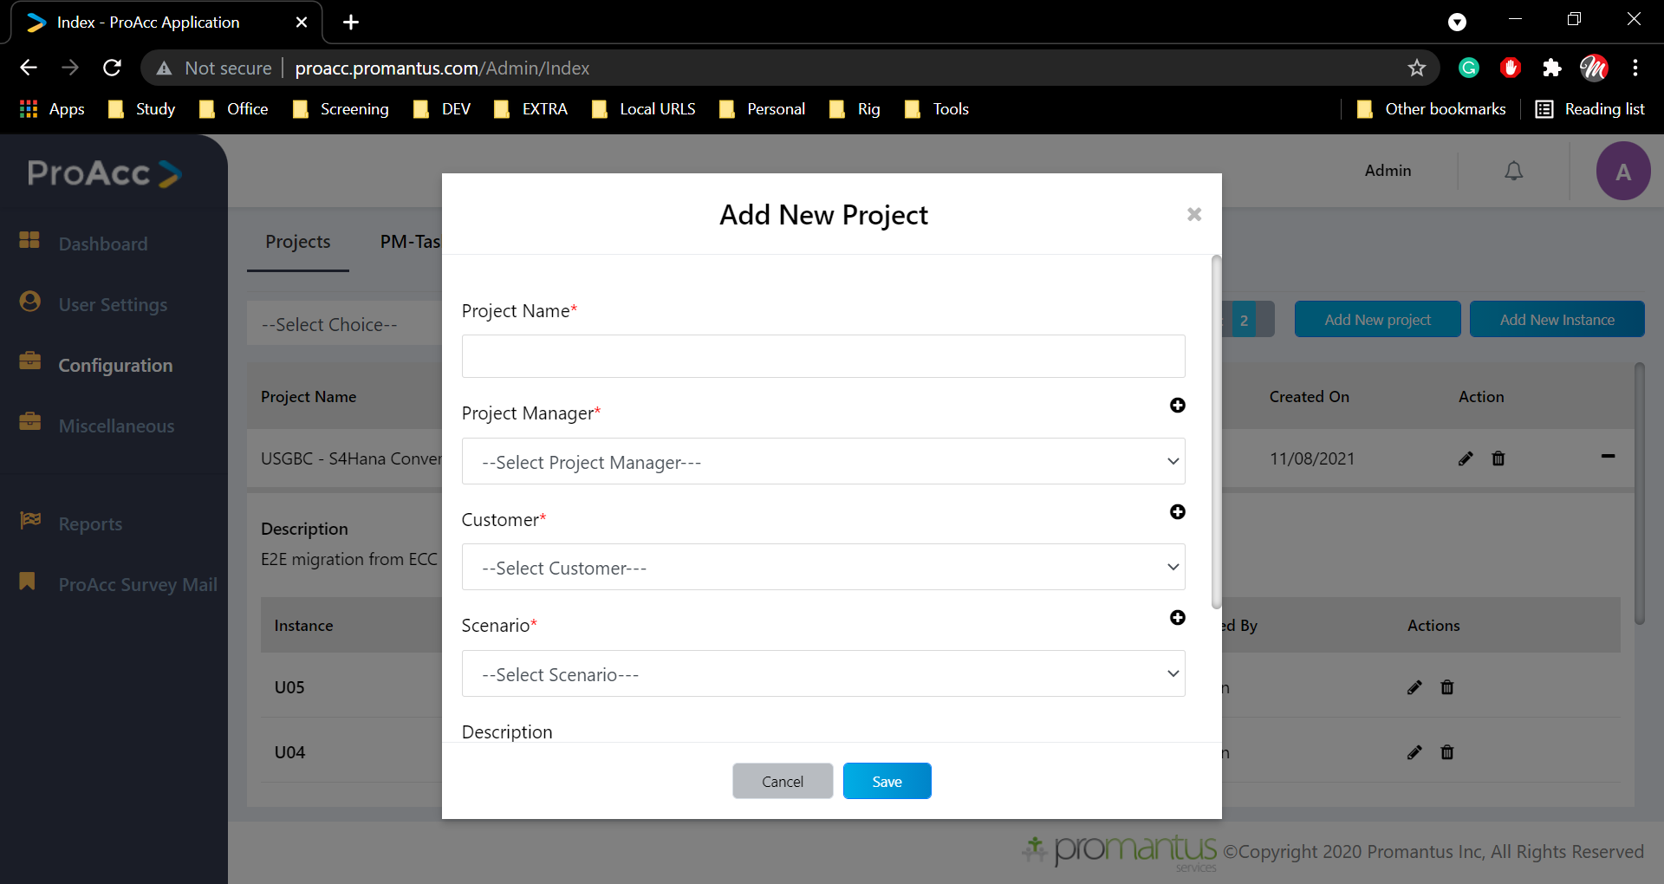
Configuration
Project :
Each project may have more than one instance. To create a project you need to project manager, customer, a scenario once you get all this you can create a project but it does nothing until you create an instance for this project
To create an instance you need to know the activity version, project name, system landscape
system landscape:
Manual, Automation
This will pull data from the SAP server in real-time to do so we need some connection details which will be added here

Slide 9
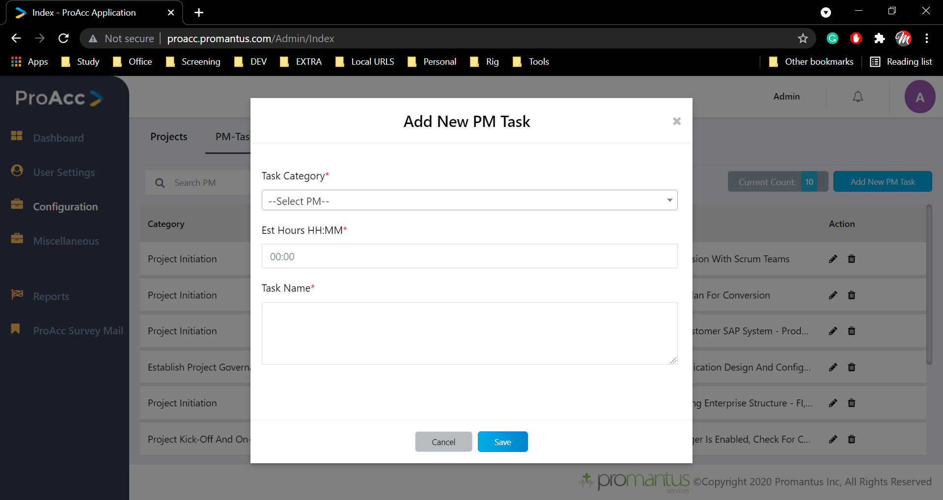
Configuration
PM-Task:
Here we will be adding tasks which are related to project manager for that we need task category , EST HH:MM ,Task Name

Slide 10

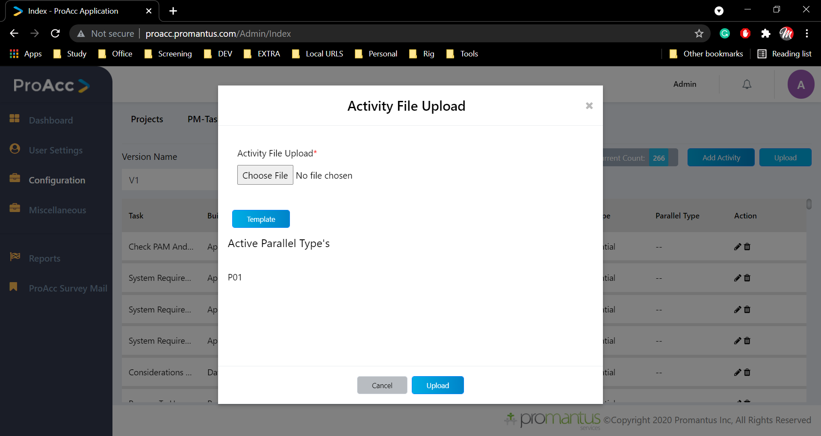
Configuration
Activity:
Here we add ,delete, export, bulk upload activity .In uploading Activity we can download the template on clicking upload button.
In that template most of the columns are drop down which is directly linked with table in the database

Slide 11
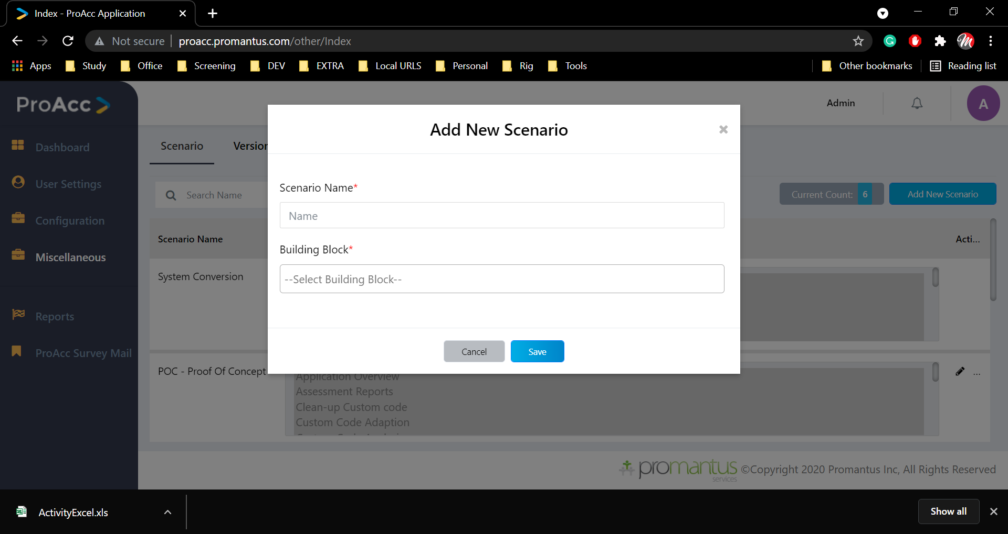
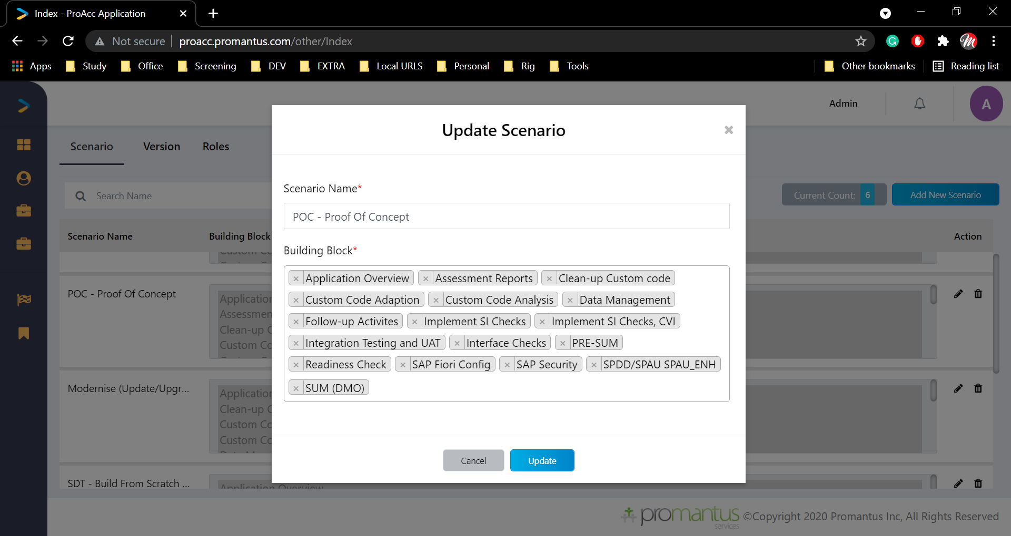
Miscellaneous
Here we have three tabs
1. Scenario
2. Version
3. Roles
Scenario:
To create a scenario, we need to know its name and Building blocks.
If there any active instance in the scenario you can't edit or delete that
Version:
It’s a list here we edit name of the version each time when we upload an Activity in the configuration a new version will be created
Roles:
We can create a new role or update the role name, but you can’t delete any

Slide 12
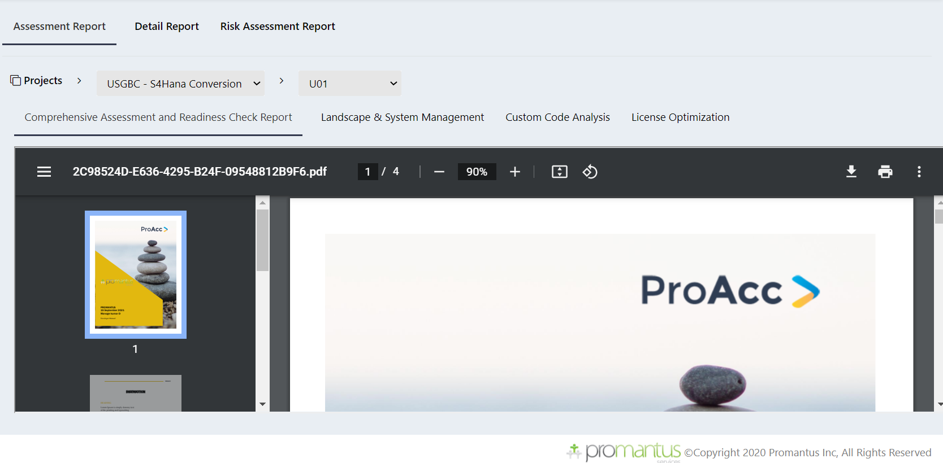
Reports
Here we have two tabs
Assessment Report’s
Detail Report’s
We need to select project and instance to view any data
Assessment Report’s:
In this we can see the following reports which are upload by PM ( Project manager)
Comprehensive Assessment & Readiness Check Report
Landscape & System Management
Custom Code Analysis
License Optimization

Slide 13
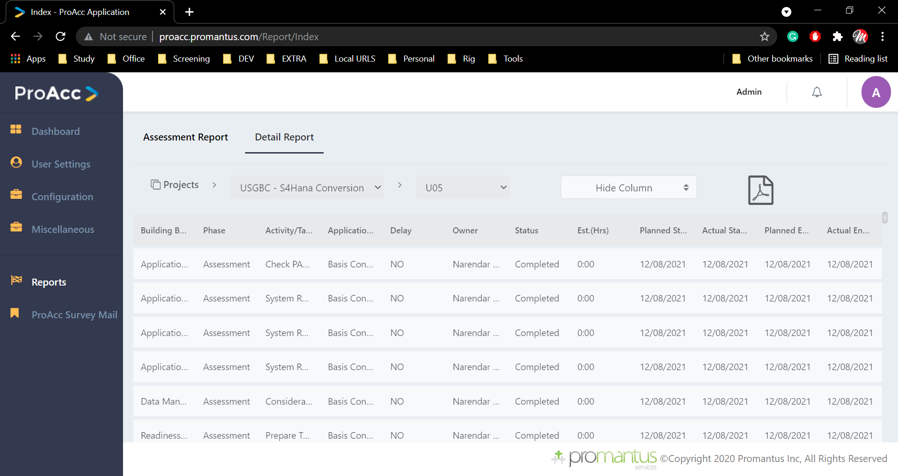
Reports
Detail Report’s:
Here we can see the task status of the project and we can export as pdf for reference

Slide 14
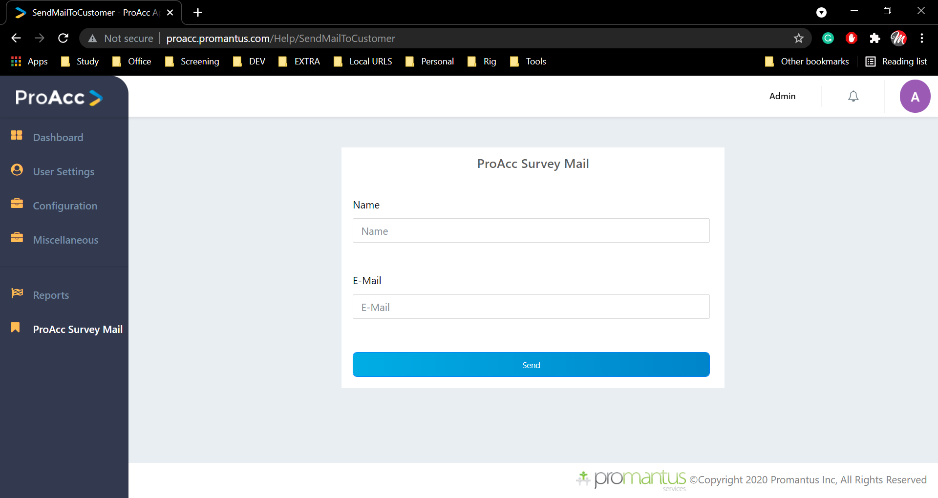
ProAcc Survey Mail
Here we ask a customer or client by providing name and mail ID
(This section is maintained by different team we are just send a mail with link)

Slide 15
Project Manager
Menu
Dashboard
PM
Progress view
Readiness Check
Task Monitoring
Reports
Issue Tracking
PROACC Survey Mail

Slide 16
Dashboard
As we seen in the Dashboard from Admin login same will be displayed.
Data will be respect to user logged in (Project Manager user and project )

Slide 17
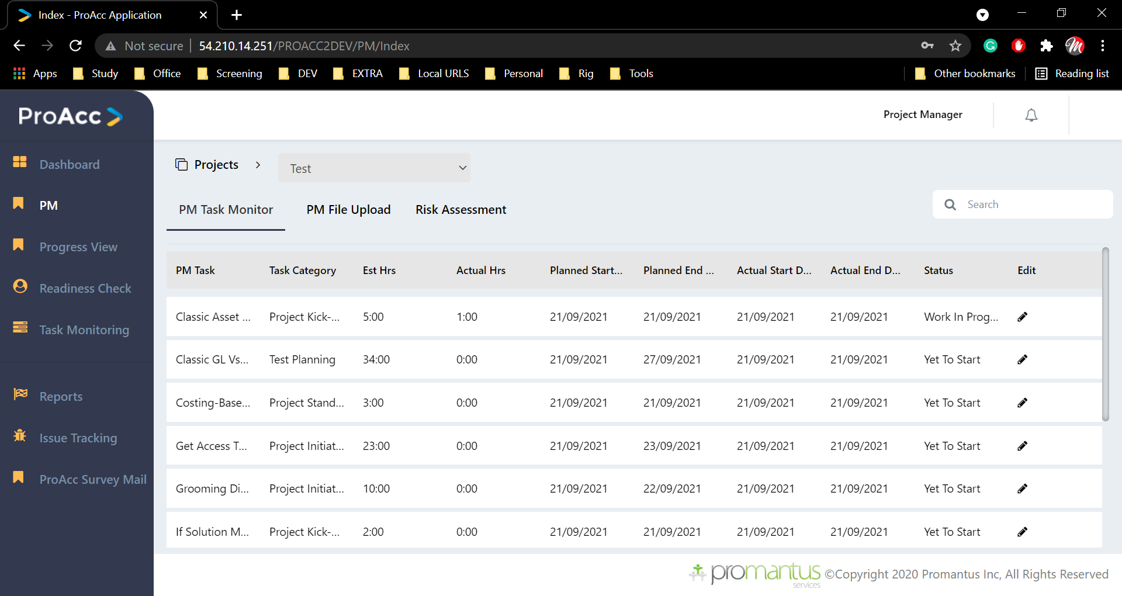
PM (Project Manger)
Here we have three tabs,
PM Task monitor
PM File upload
Risk Assessment
PM Task monitor:
Here we are pulling the data which are related to project. If this is the first time it will be pulled from master from admin which we added

Slide 18
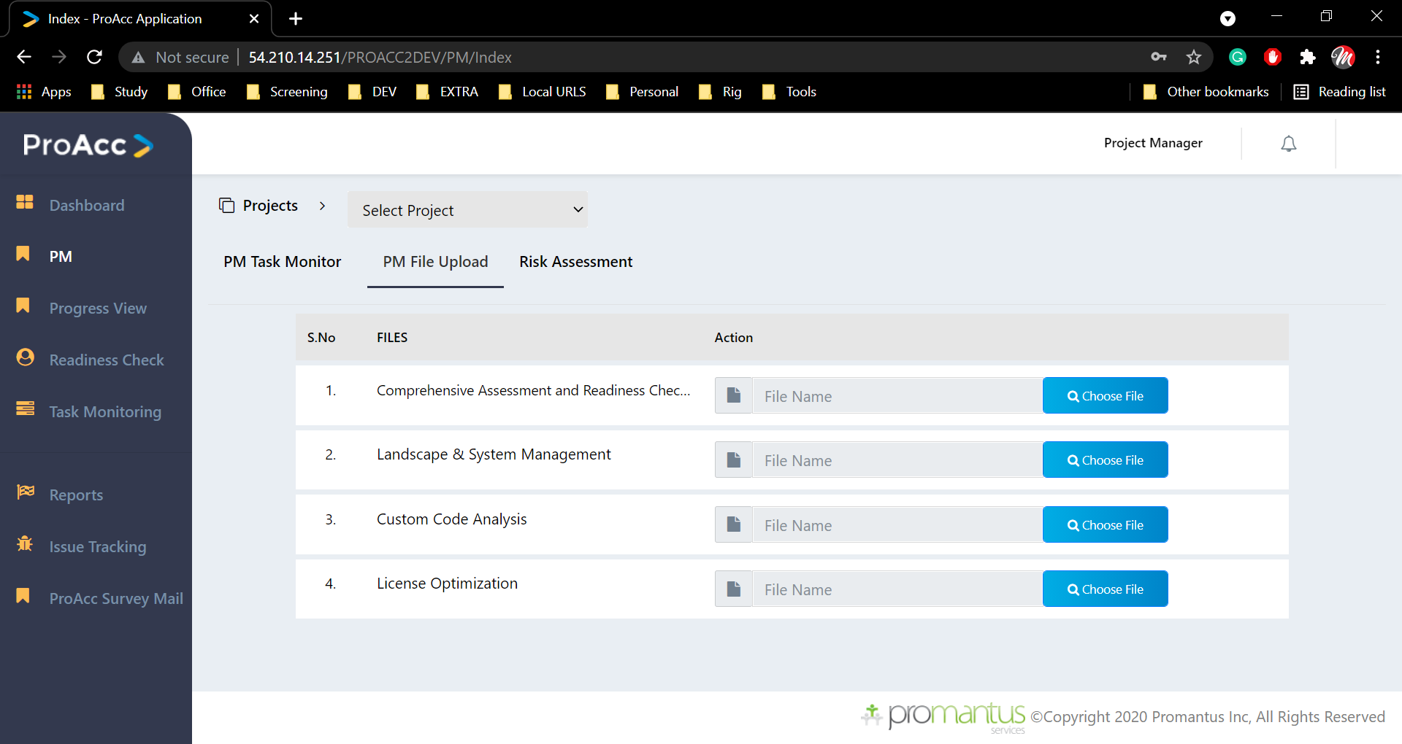
PM (Project Manger)
PM File upload:
Here we will be uploading documents which are unique to the project by the manager following the list of documents
Comprehensive Assessment & Readiness Check Report
Landscape & System Management
Custom Code Analysis
License Optimization

Slide 19
PM (Project Manger)
PM File upload:
Here we will be uploading documents which are unique to the project by the manager following the list of documents
Comprehensive Assessment & Readiness Check Report
Landscape & System Management
Custom Code Analysis
License Optimization

Slide 20
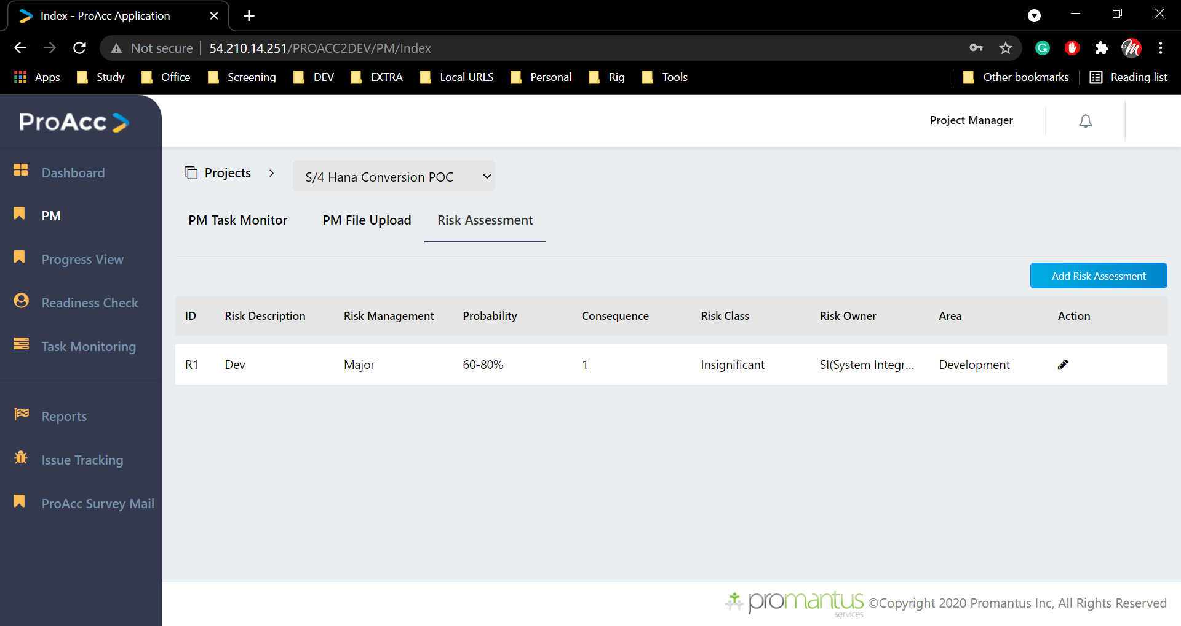
PM (Project Manger)
Risk Assessment:
Here manager can add the risk value in that the find in the project

Slide 21
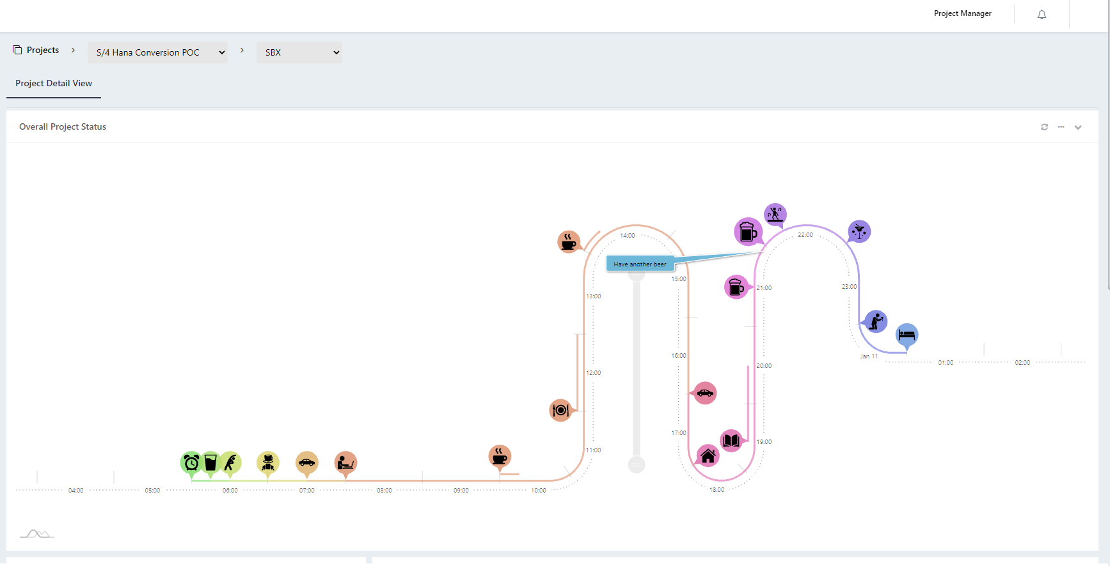
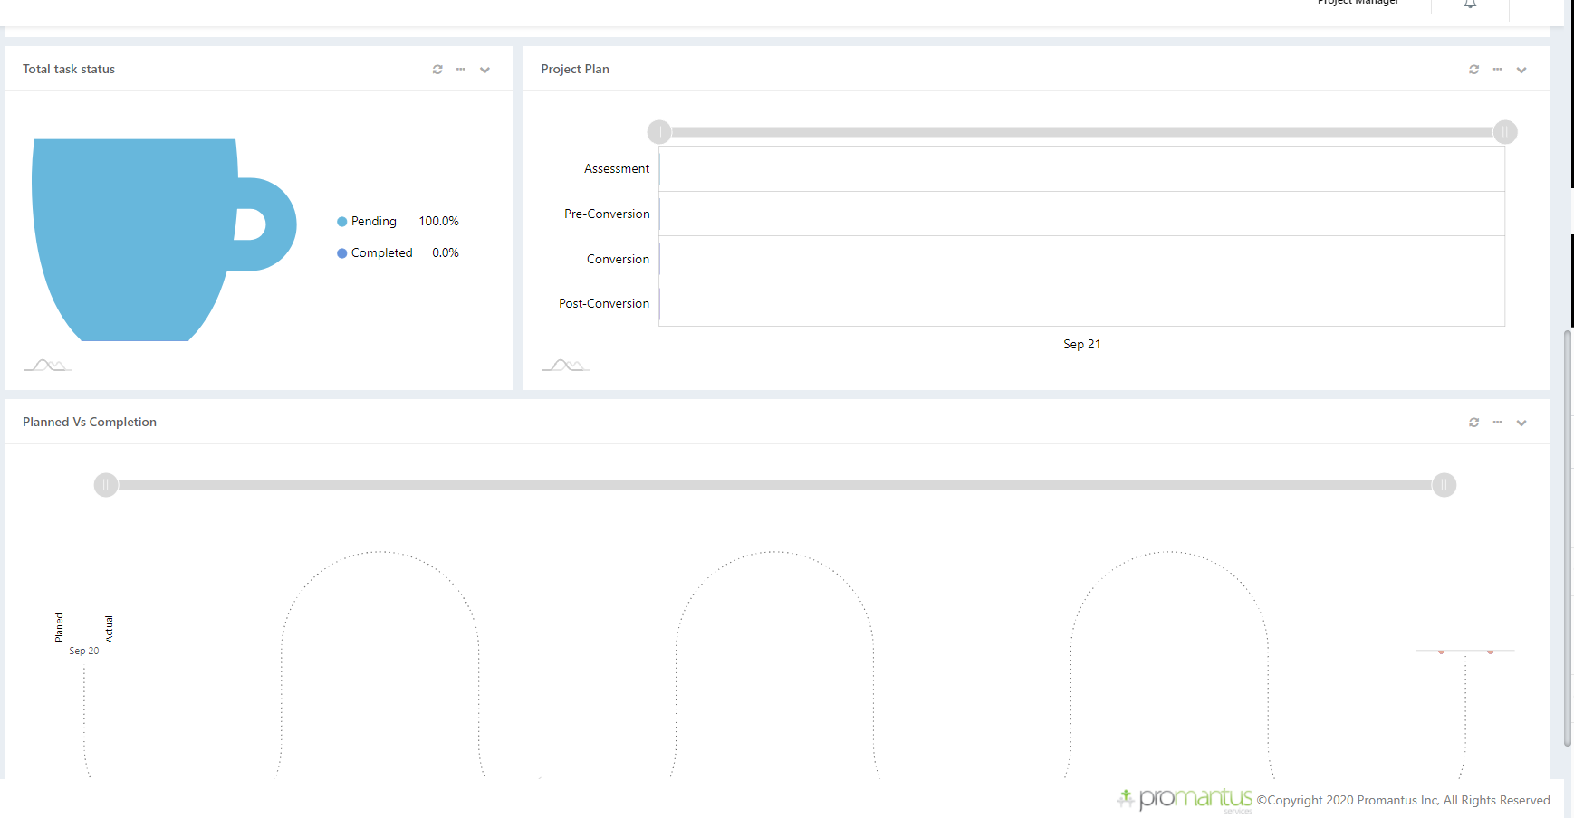
Progress View
This page is to show the different status view of the ongoing project (TBD)

Slide 22
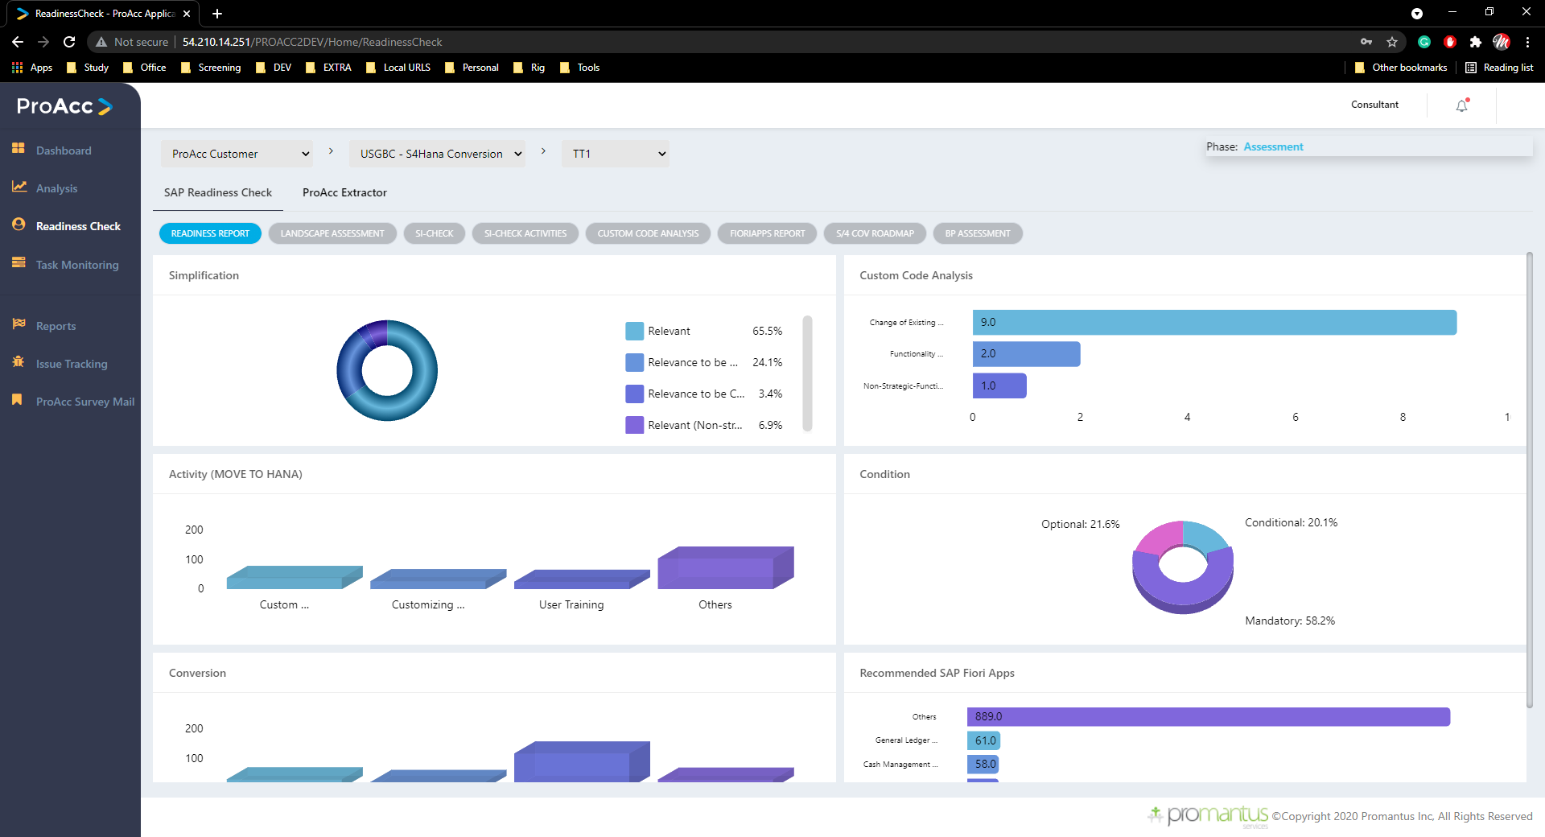
Readiness Check-SAP Readiness check
Here As we can see the chart’s which are reflecting after consultant has uploaded all the SAP documents in the Analysis

Slide 23
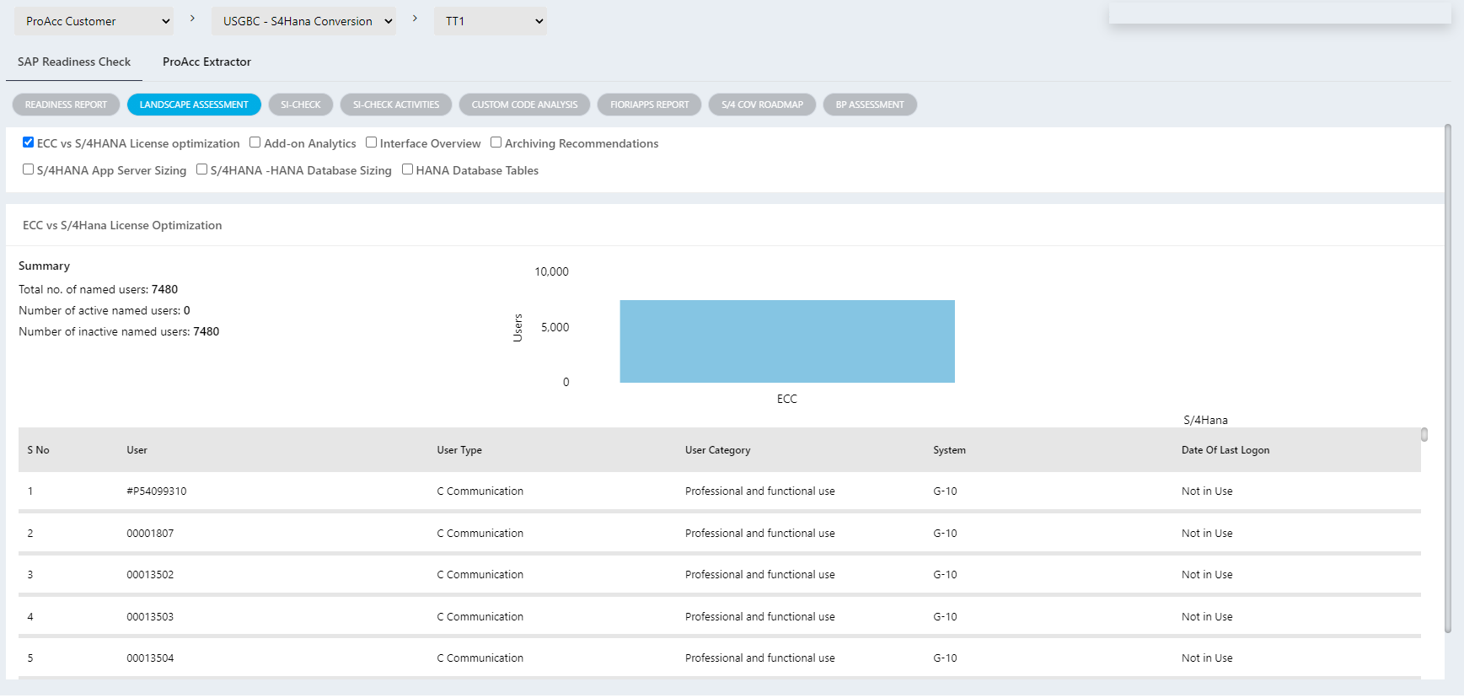
Readiness Check-SAP Readiness check
Here As we can see the chart’s which are reflecting after consultant has uploaded all the SAP documents in the Analysis

Slide 24
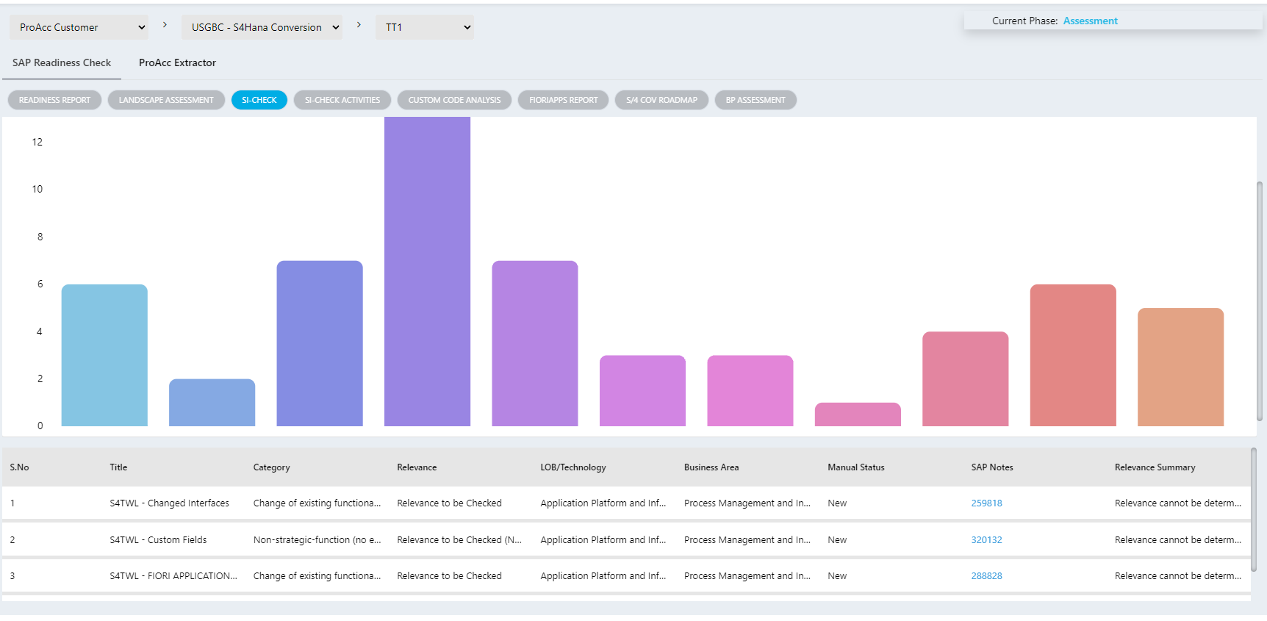
Readiness Check-SAP Readiness check
Here As we can see the chart’s which are reflecting after consultant has uploaded all the SAP documents in the Analysis

Slide 25
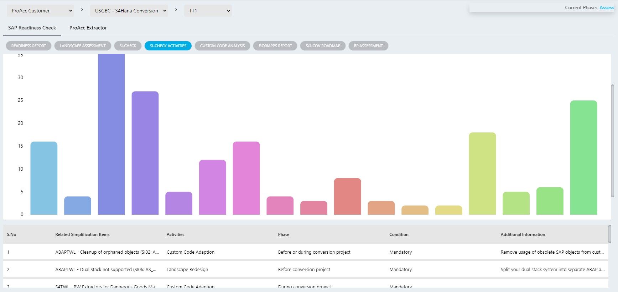
Readiness Check-SAP Readiness check
Here As we can see the chart’s which are reflecting after consultant has uploaded all the SAP documents in the Analysis

Slide 26
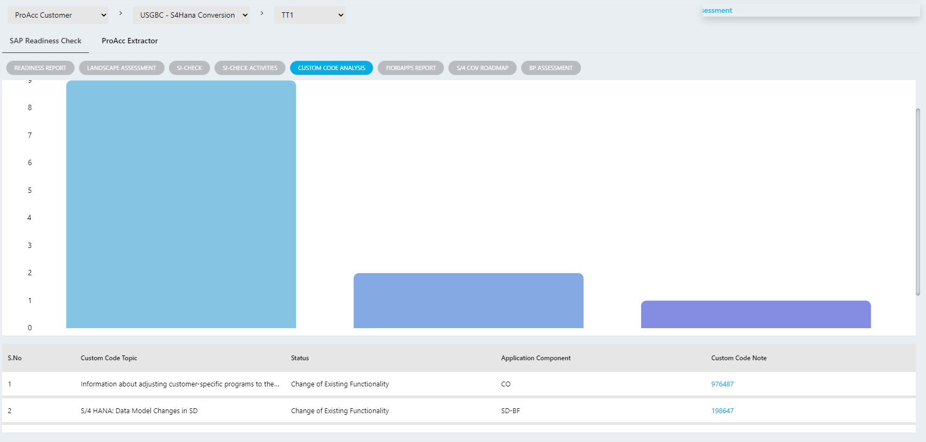
Readiness Check-SAP Readiness check
Here As we can see the chart’s which are reflecting after consultant has uploaded all the SAP documents in the Analysis

Slide 27
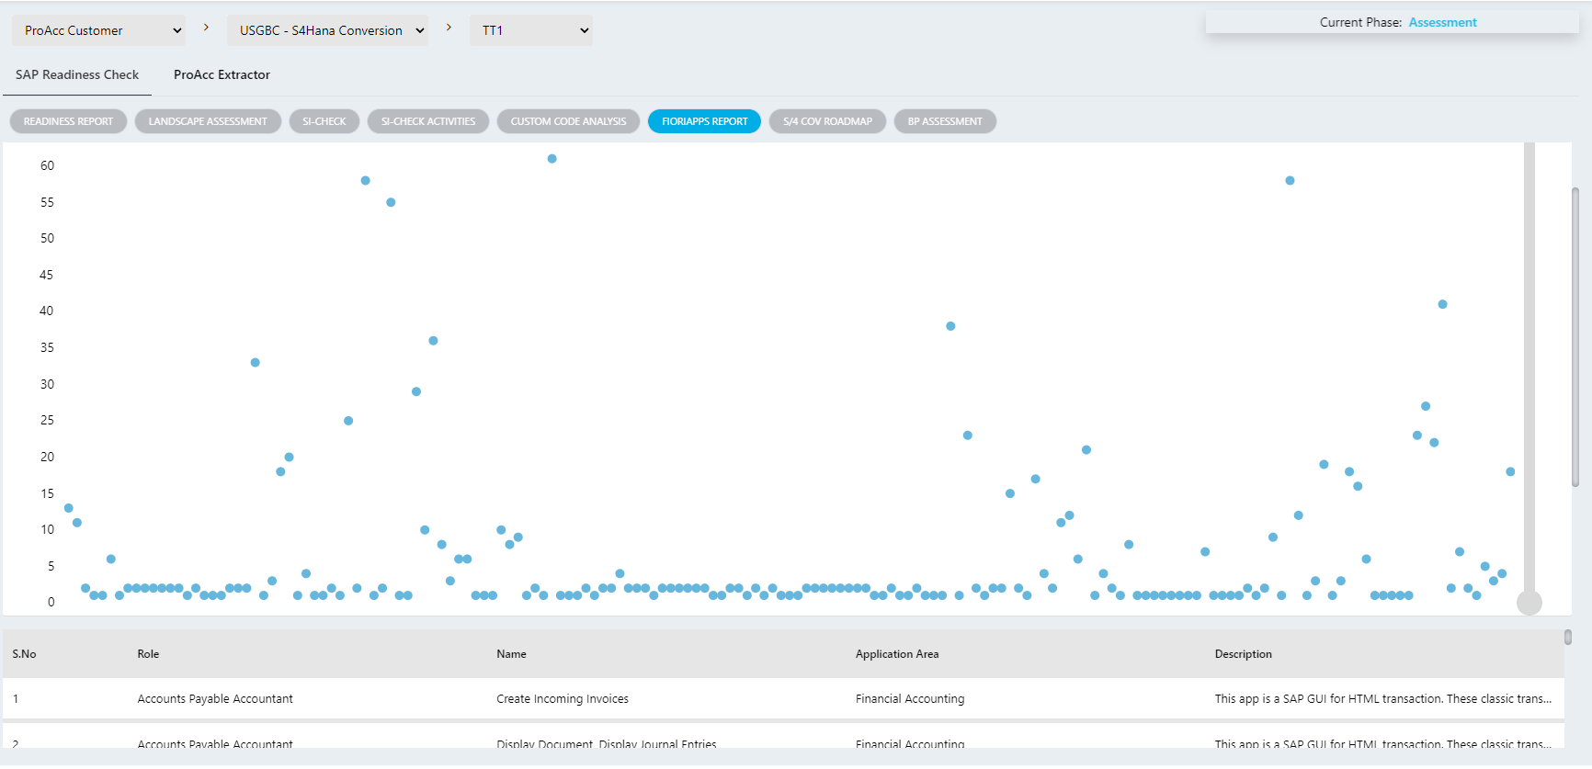
Readiness Check-SAP Readiness check
Here As we can see the chart’s which are reflecting after consultant has uploaded all the SAP documents in the Analysis

Slide 28
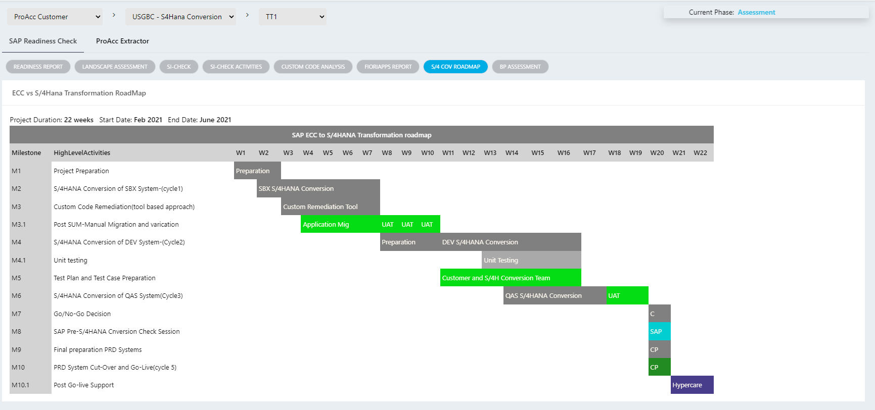
Readiness Check-SAP Readiness check
Here As we can see the chart’s which are reflecting after consultant has uploaded all the SAP documents in the Analysis

Slide 29
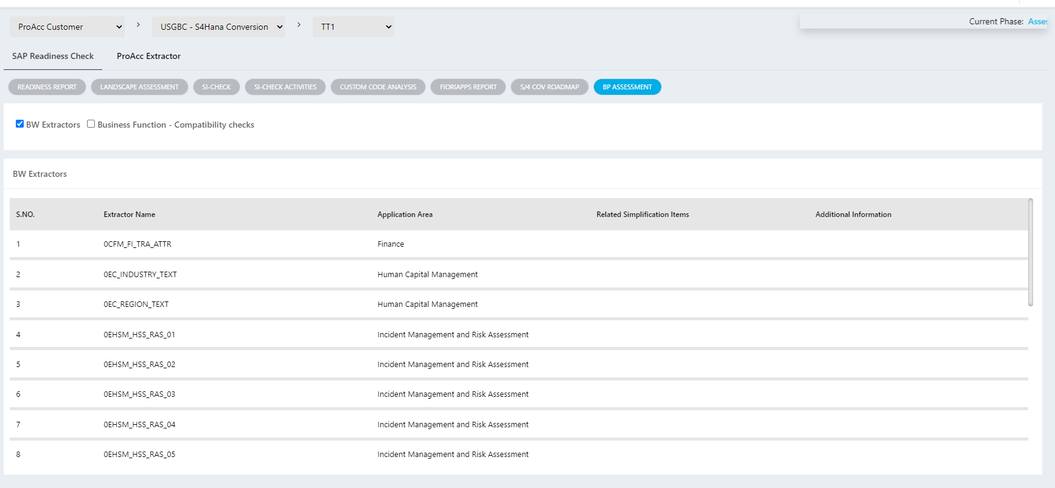
Readiness Check SAP Readiness check
Here As we can see the chart’s which are reflecting after consultant has uploaded all the SAP documents in the Analysis

Slide 30
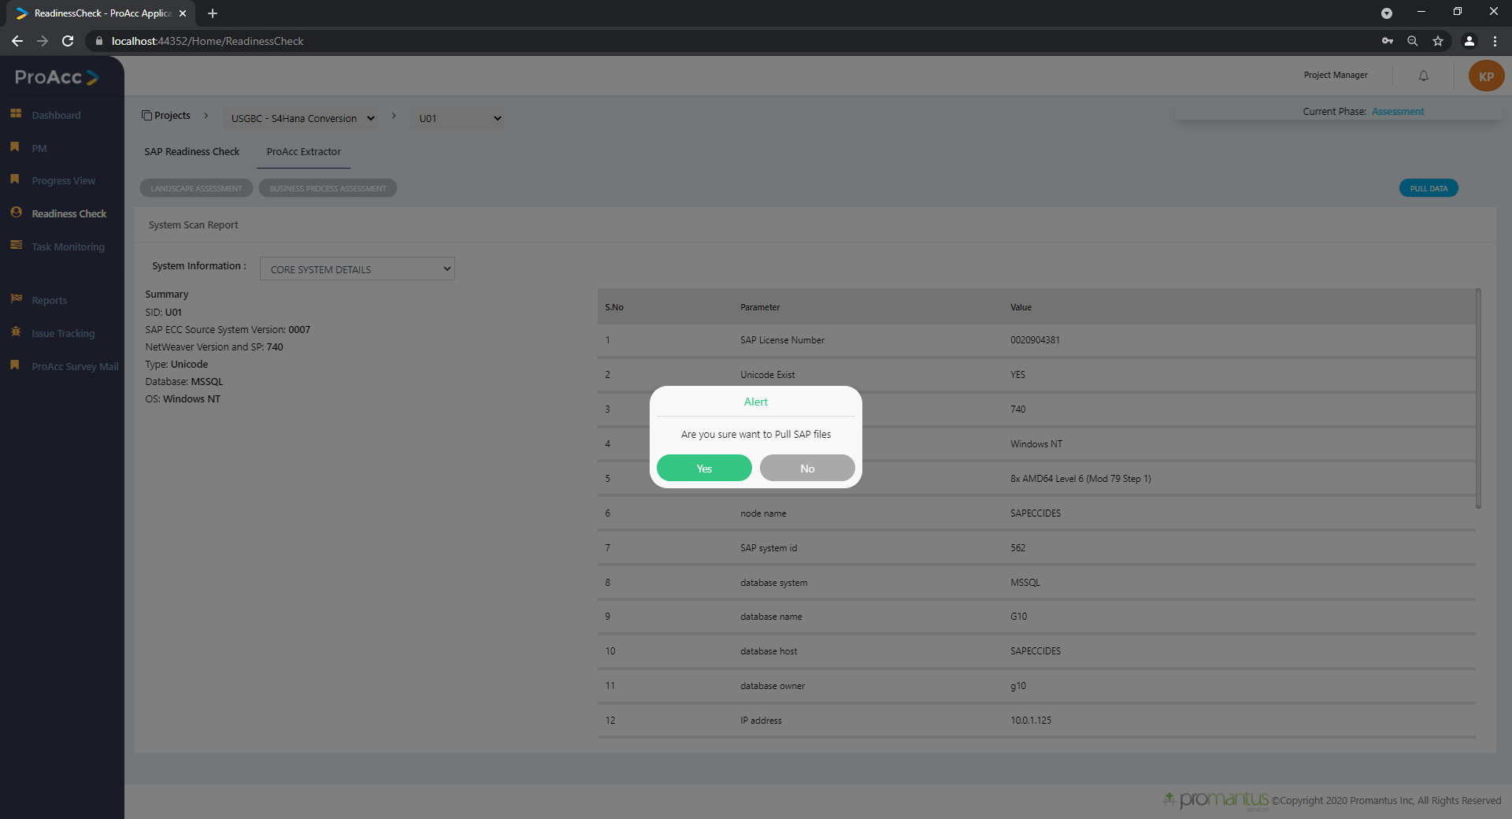
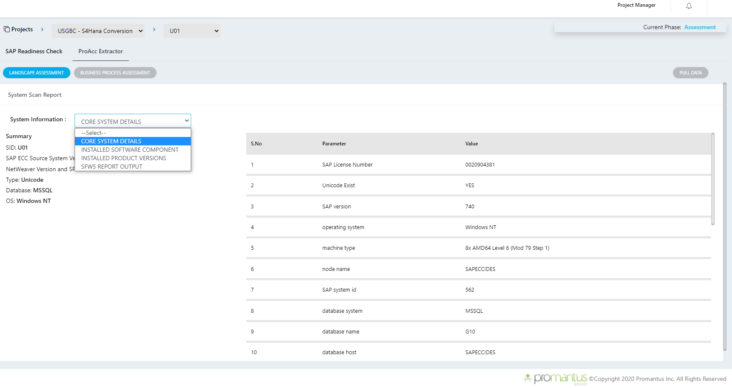
Readiness check PROACC Extractor -Landscape
Here We will be pulling latest data from SAP instance and present to the user

Slide 31
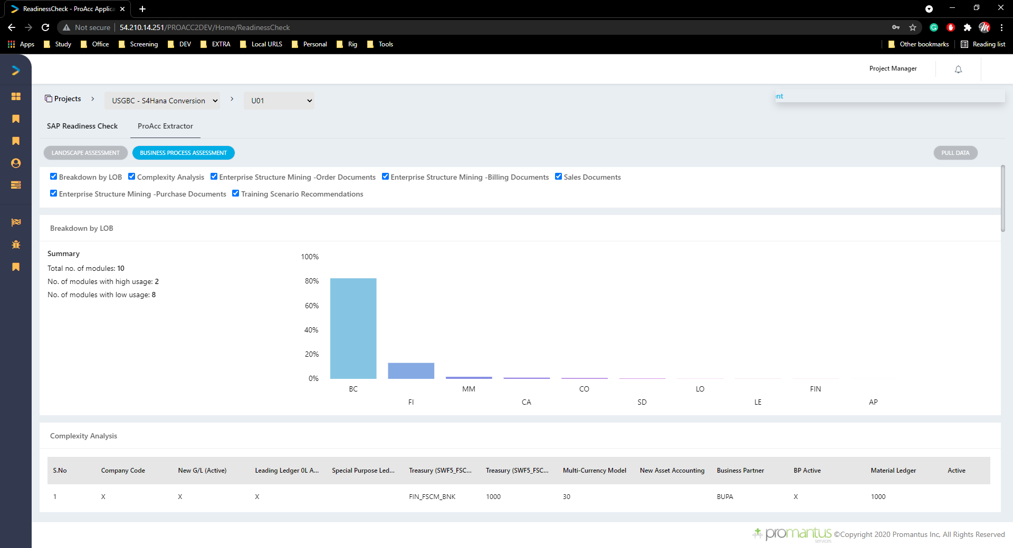
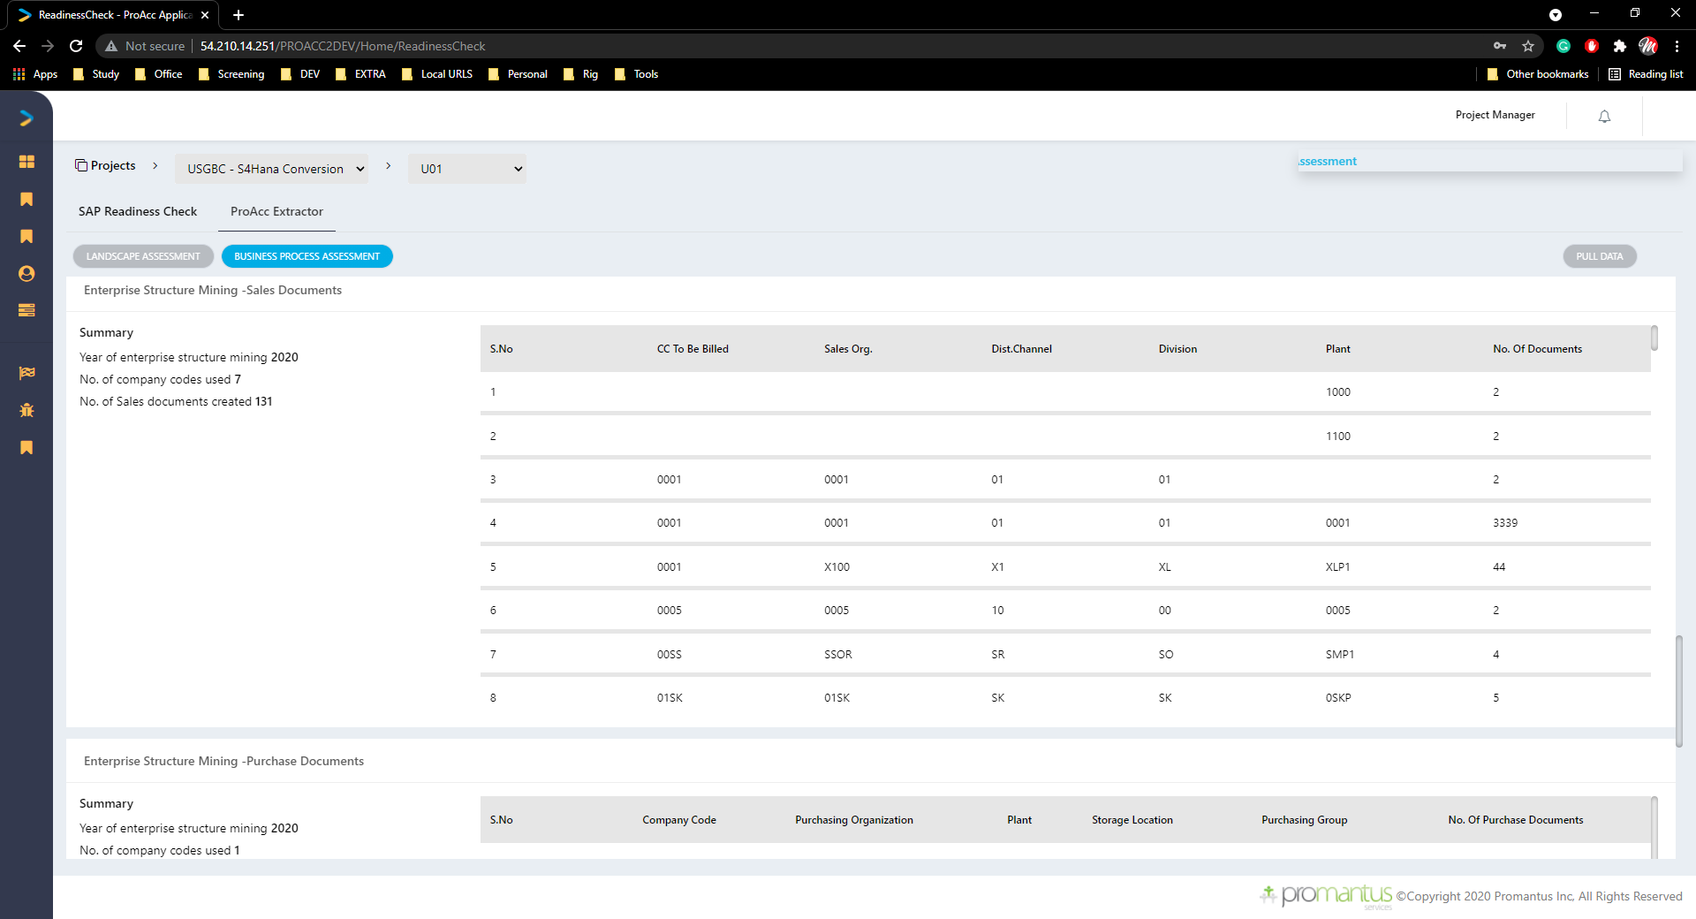
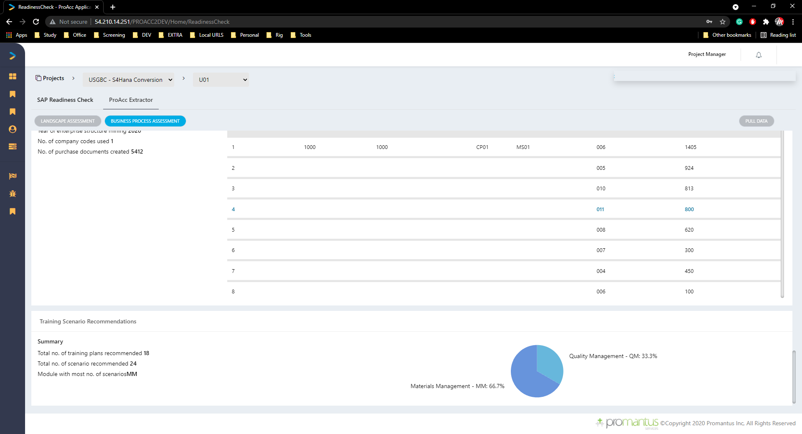
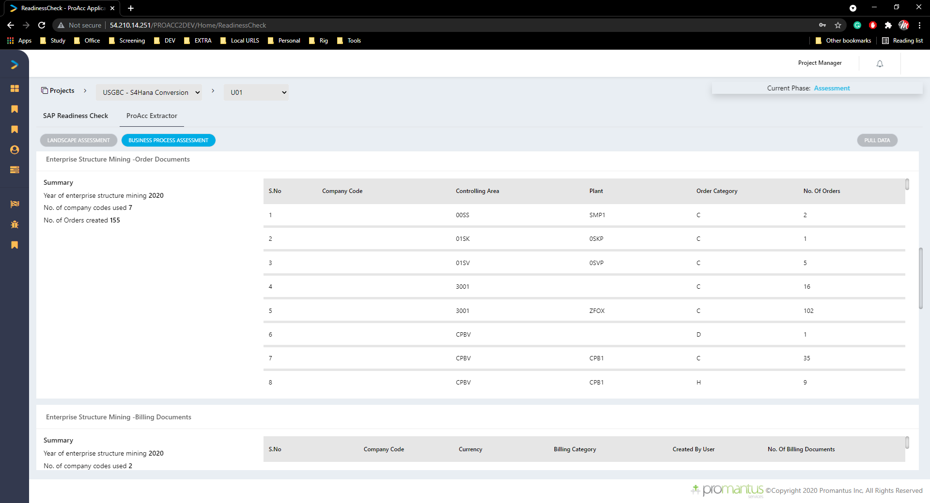
Readiness check PROACC Extractor -Business process
This data will be reflected after SAP file upload is done in Analysis by consultant

Slide 32
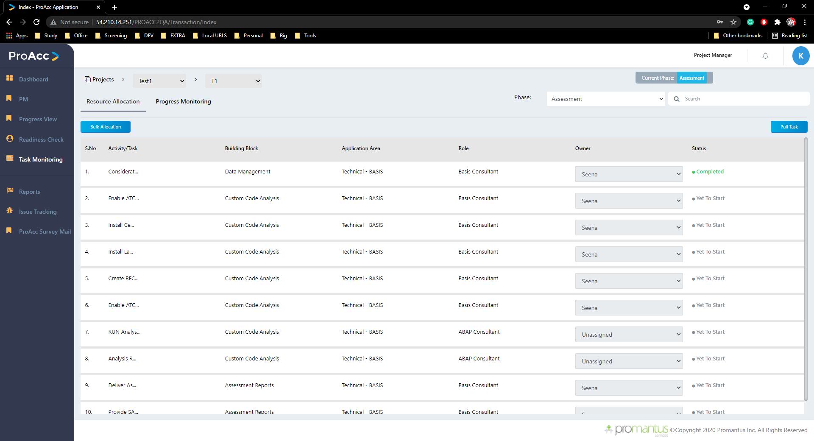
Task Monitoring
Resource Allocation:
Task monitoring is unique to its login user type
Here he can be able to assign to the consultant with respective to the role
Bulk Allocation is also possible
We can also pull the new task from the Master Activity
The system Always follow Structure Flow

Slide 33
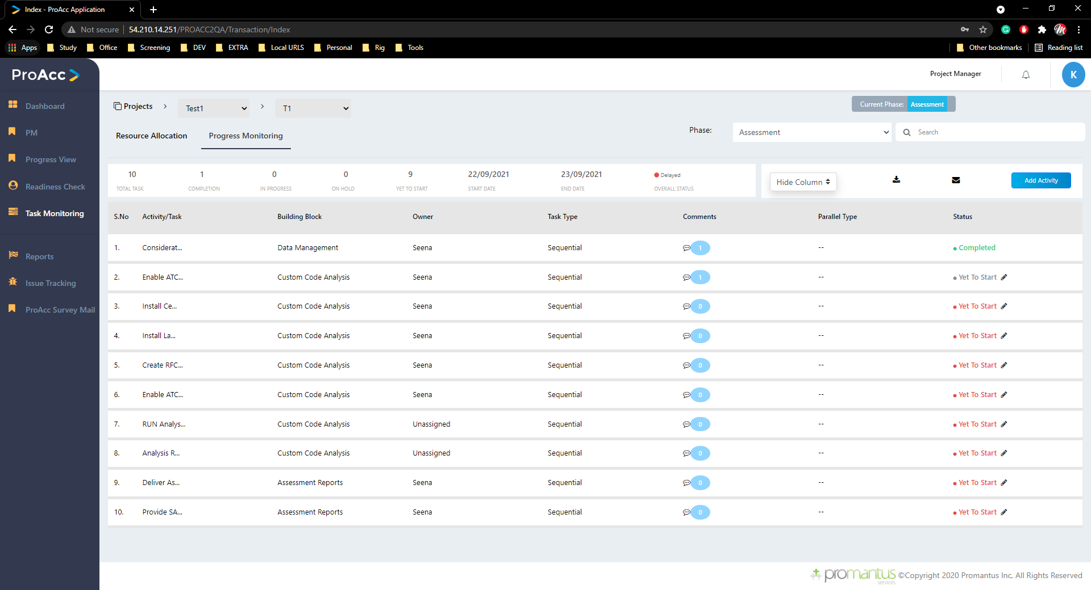
Task Monitoring
Progress Monitoring :
Task monitoring is unique to its login user type
Here he can be able to change the status like “On hold”
Add activity which will affect to this instance alone without disturbing version or master activity
Here we download the data as pdf or send a mail with this attachment

Slide 34
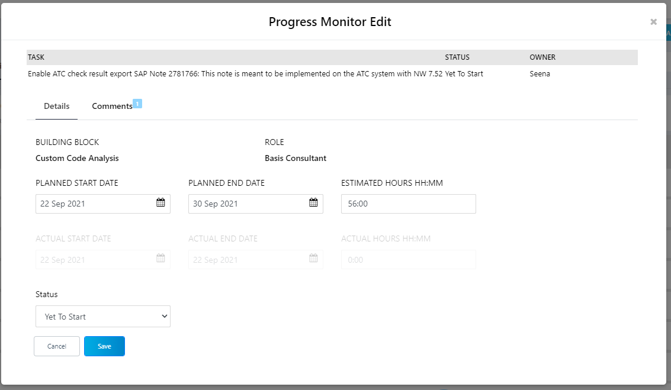
Task Monitoring
Progress Monitoring Edit :
Planned start & end date
Status
These are mandatory fields to edit

Slide 35
Reports
Which directly related user login (Project Access)

Slide 36
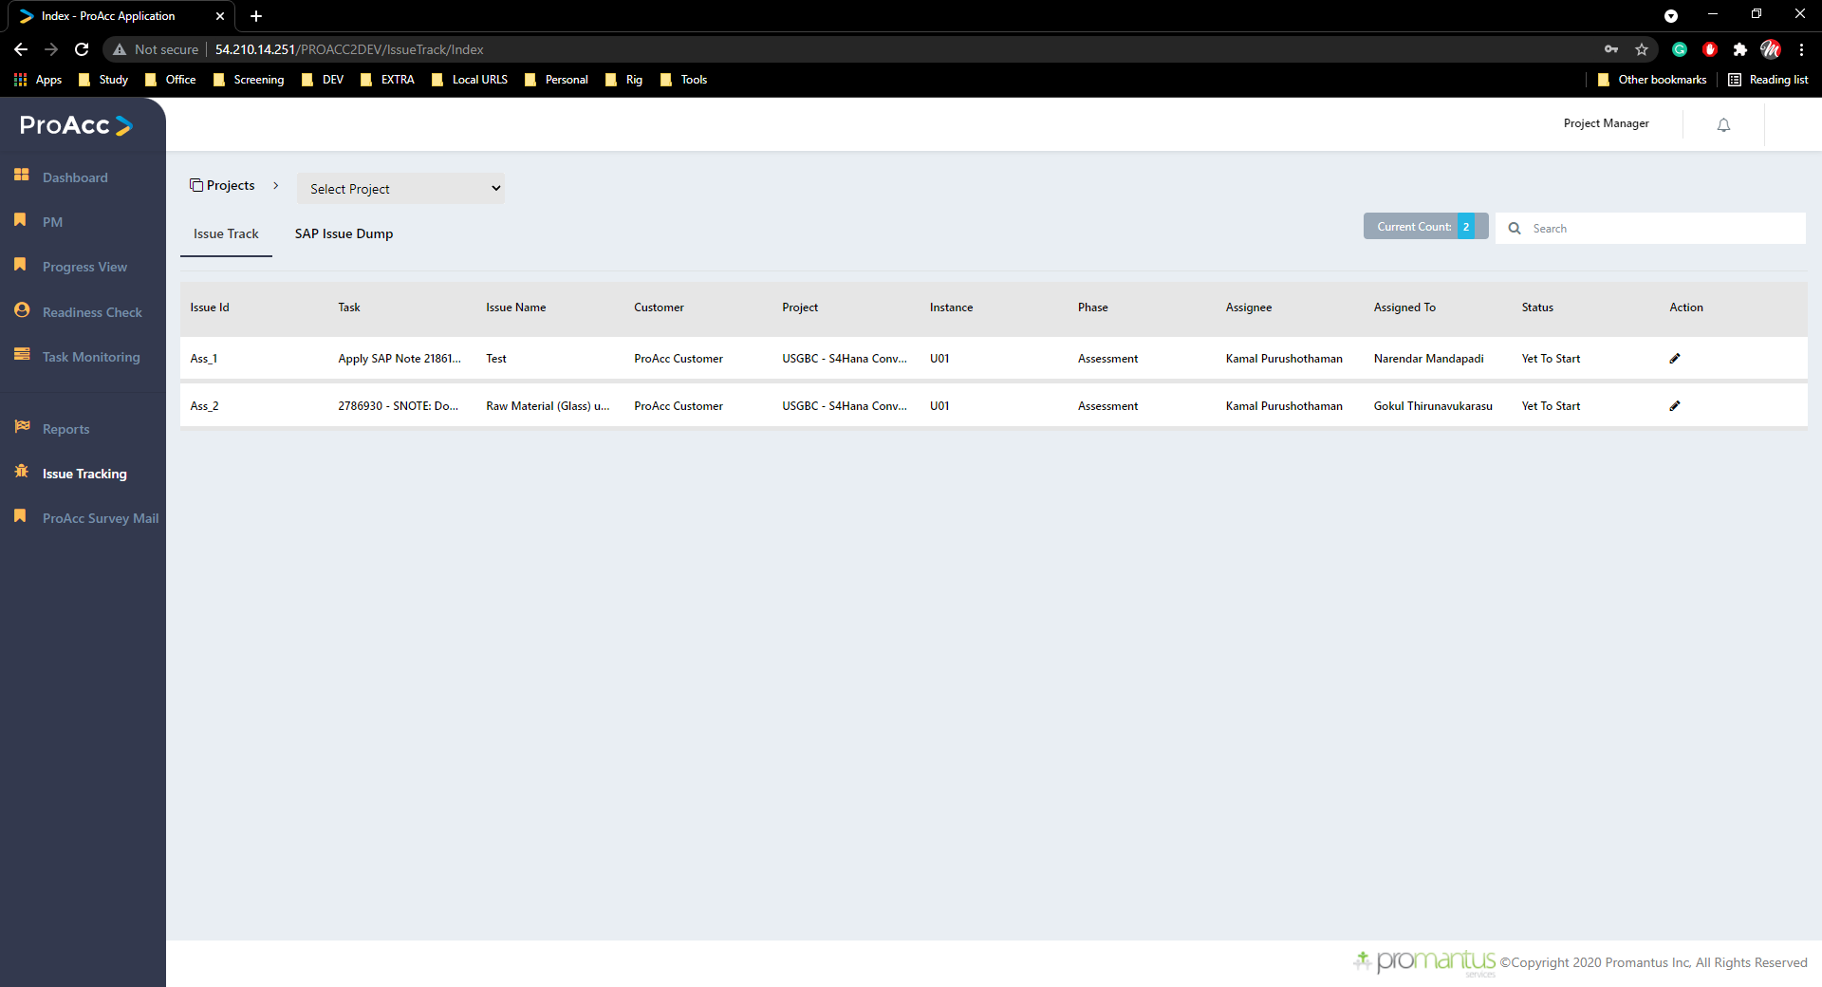
Issue Tracking
Issue Tracking:
Here we can add any issue if we found in the project and that can be monitored
Respective Assignee will be notified by the mail

Slide 37
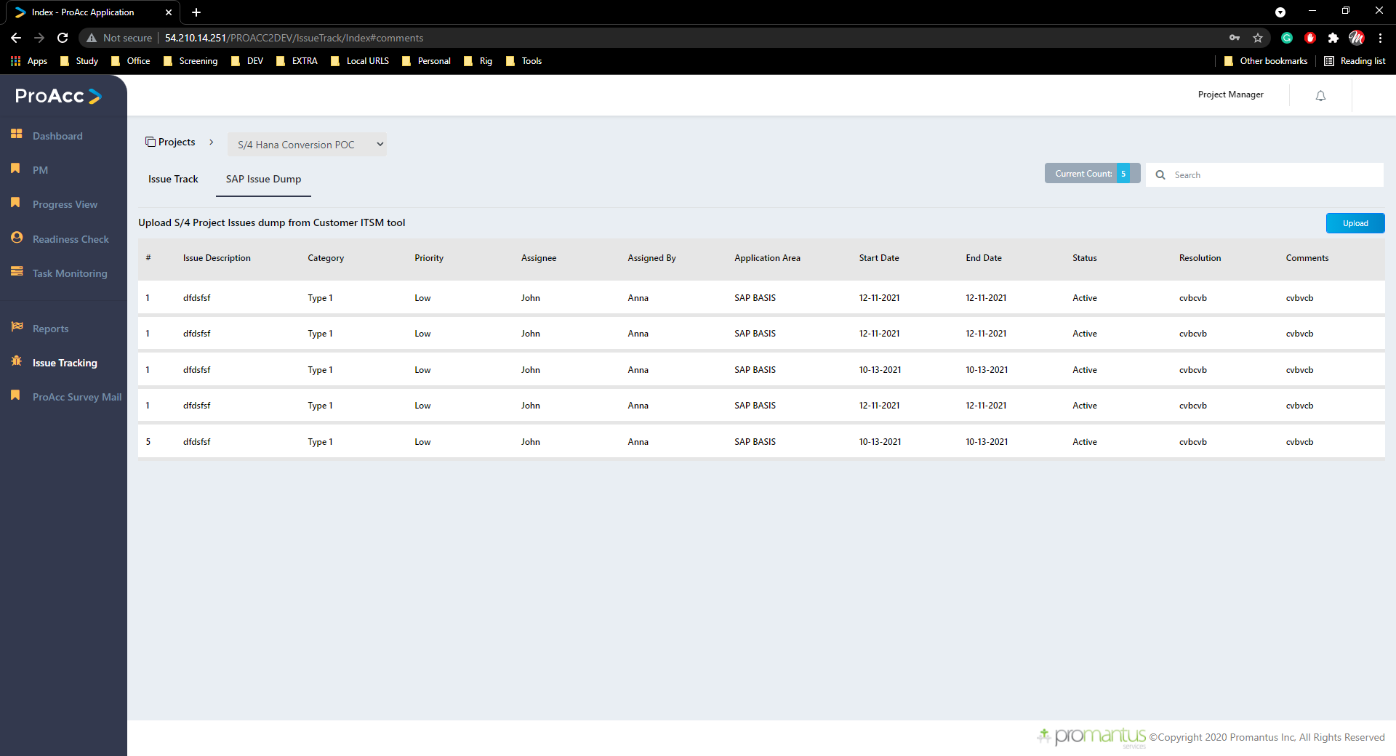
Issue Tracking
Issue Dump:
Here we can upload the SAP issues that taken as back up with respect to project
Uploading excel should follow the temple structure that’s defined

Slide 38
PROACC Survey Mail

Slide 39
Consultant
Menu
Dashboard
Analysis
Readiness Check
Task Monitoring
Issue Tracking
Reports
PROACC Survey Mail

Slide 40
Dashboard
As we seen in the Dashboard from Admin login same will be displayed.
Data will be respect to user logged in (Project Manager user and project )

Slide 41
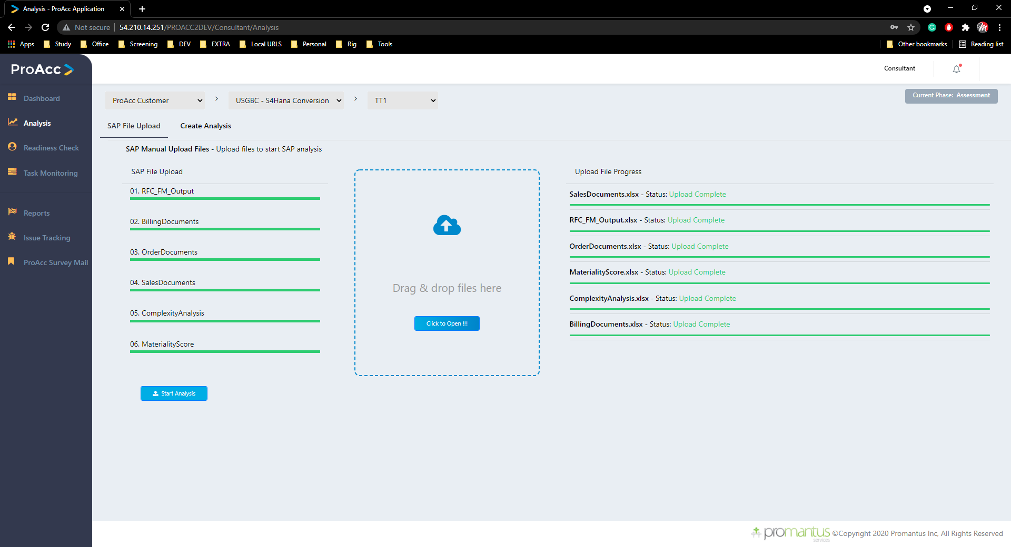
Analysis
SAP File upload:
We will be uploading the 6 SAP documents which will then reflected in readiness check

Slide 42
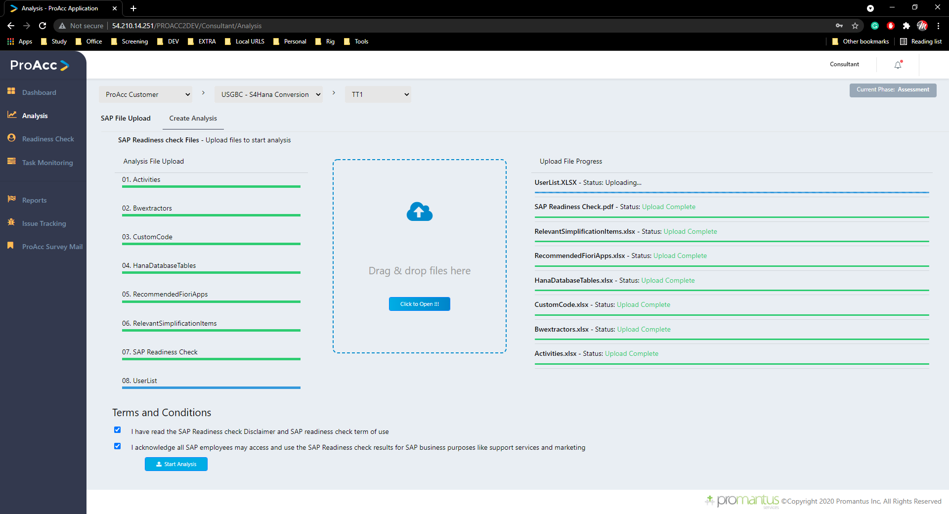
Analysis
Create Analysis:
We will be uploading the 8 SAP documents which will then reflected in readiness check

Slide 43
Readiness Check
As we seen in the Readiness check from PM login same will be displayed.
Data will be respect to user logged in (Project & instance)

Slide 44
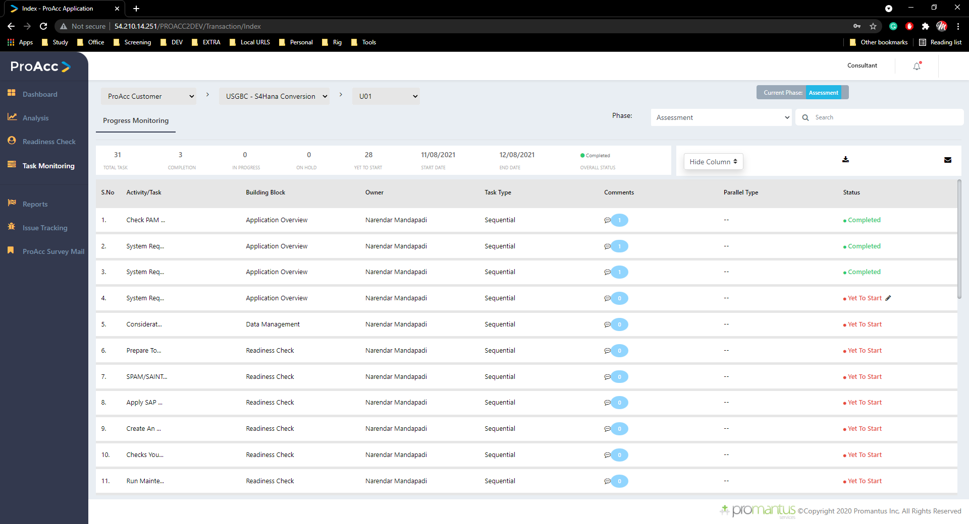
Task Monitoring
Progress Monitoring :
Task monitoring is unique to its login user type
Here he can be able to change the status like “completed ,Work In Progress ,Yet to start”
Here we download the data as pdf or send a mail with this attachment
Consultant can edit only the task that are assigned to him alone

Slide 45
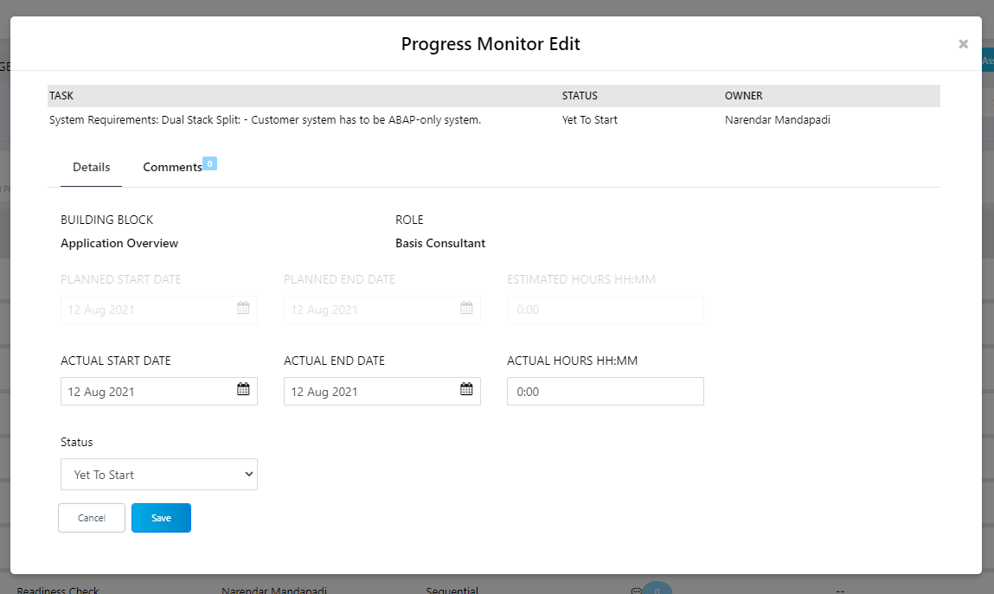
Task Monitoring
Progress Monitoring Edit :
Actual start & end date
Status
These are mandatory fields to edit

Slide 46
Reports
Which directly related user login (Project Access)

Slide 47
Issue Tracking
Which directly related user login (Project Access)

Slide 48
PROACC Survey Mail

Slide 49
Customer
Menu
Dashboard
Readiness Check
Task Monitoring
Reports
Issue Tracking
PROACC Survey Mail

Slide 50
Dashboard
As we seen in the Dashboard from Admin login same will be displayed.
Data will be respect to user logged in (Project Manager user and project )

Slide 51
Readiness Check
As we seen in the Readiness check from PM login same will be displayed.
Data will be respect to user logged in (Project & instance)

Slide 52
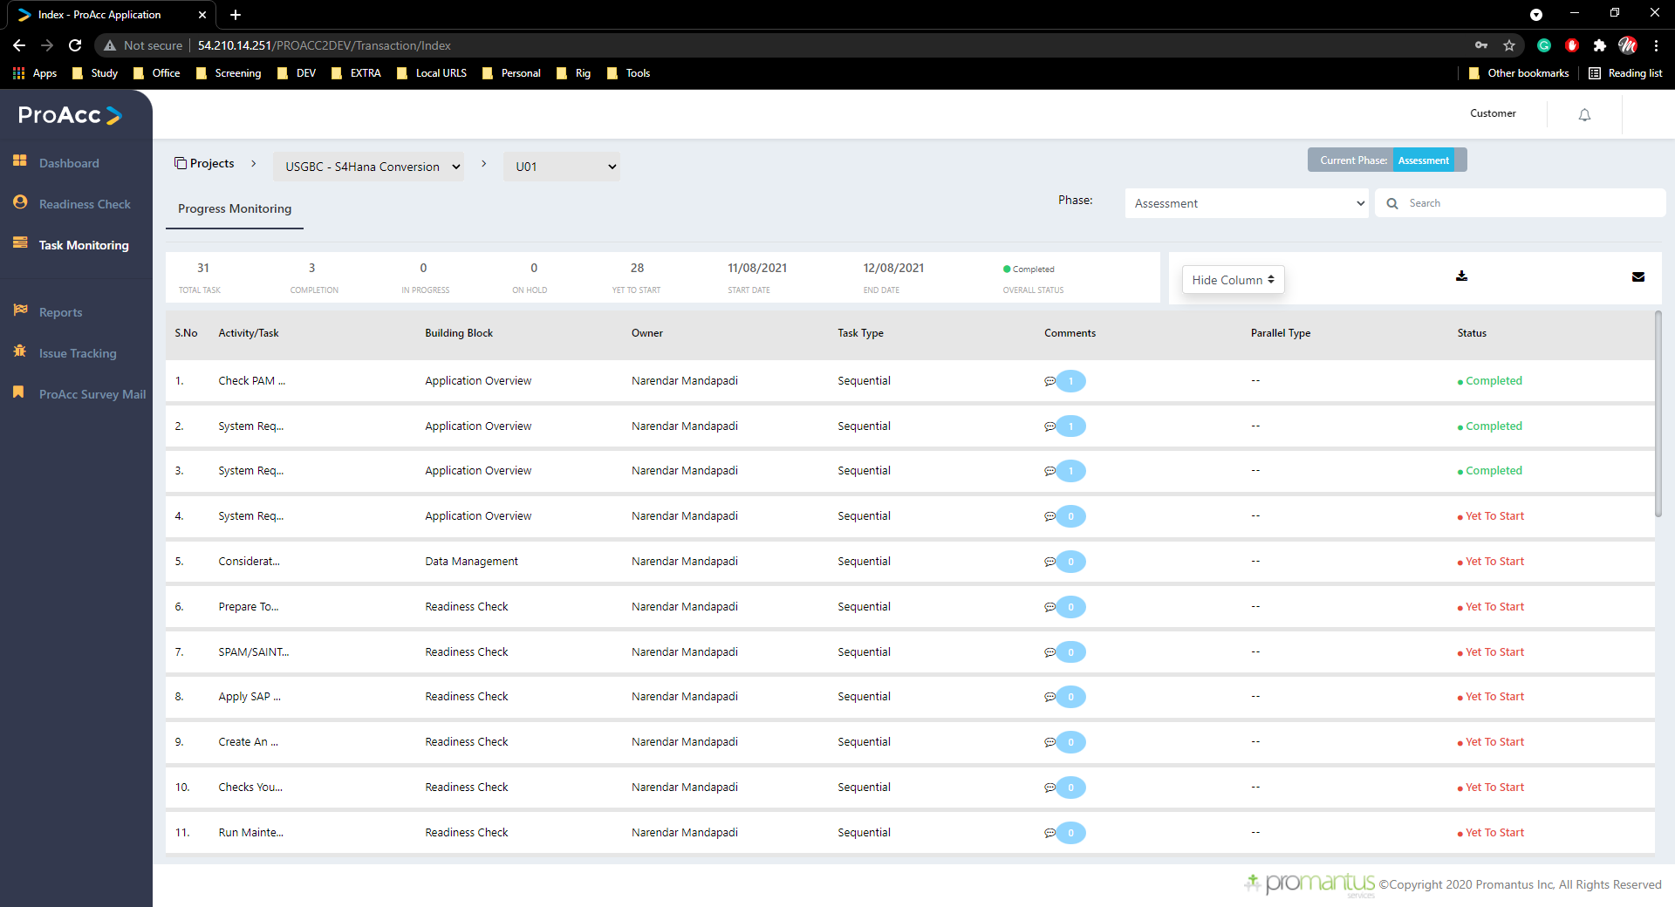
Task Monitoring
Progress Monitoring :
Task monitoring is unique to its login user type
Here he can’t edit any data
Here we download the data as pdf or send a mail with this attachment
Customer can only be able to view & follow the current status of his project

Slide 53
Reports
Which directly related user login (Project Access)

Slide 54
Issue Tracking
Which directly related user login (Project Access)

Slide 55
PROACC Survey Mail

